Slide 1



Introduction to Pyspark
Rama Shankar

Slide 2

Pyspark

Slide 3
Spark
Apache Spark is an open source cluster computing framework for real-time data processing.
The main feature of Apache Spark is its in-memory cluster computing that increases the processing speed of an application.
Spark provides an interface for programming entire clusters with implicit data parallelism and fault tolerance.
It is designed to cover a wide range of workloads such as batch applications, iterative algorithms, interactive queries, and streaming

Slide 4
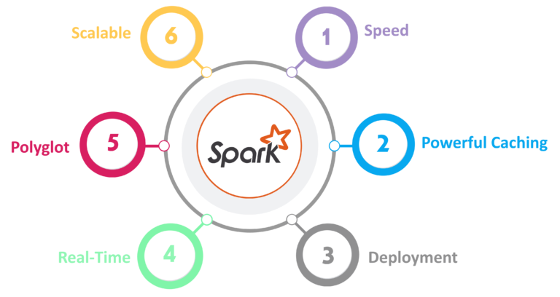

Slide 5
Speed
Spark runs up to 100 times faster than Hadoop MapReduce for large-scale data processing. It is also able to achieve this speed through controlled partitioning.
Powerful Caching
Simple programming layer provides powerful caching and disk persistence capabilities.
Deployment
It can be deployed through Mesos, Hadoop via YARN, or Spark’s own cluster manager.
Real-Time
It offers Real-time computation & low latency because of in-memory computation.
Polyglot
Spark provides high-level APIs in Java, Scala, Python, and R. Spark code can be written in any of these four languages. It also provides a shell in Scala and Python.

Slide 6
Spark Architecture Overview
Apache Spark has a well-defined layered architecture where all the spark components and layers are loosely coupled. This architecture is further integrated with various extensions and libraries. Apache Spark Architecture is based on two main abstractions:
Resilient Distributed Dataset (RDD)
Directed Acyclic Graph (DAG)

Slide 7
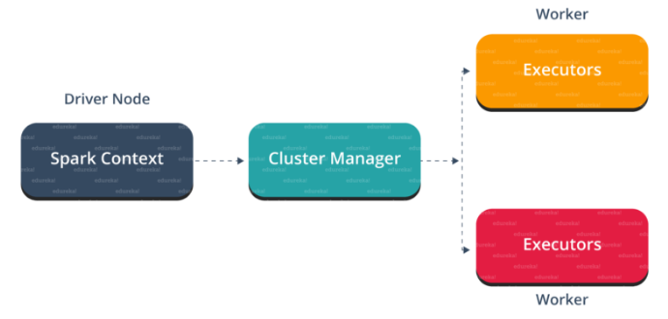

Slide 8
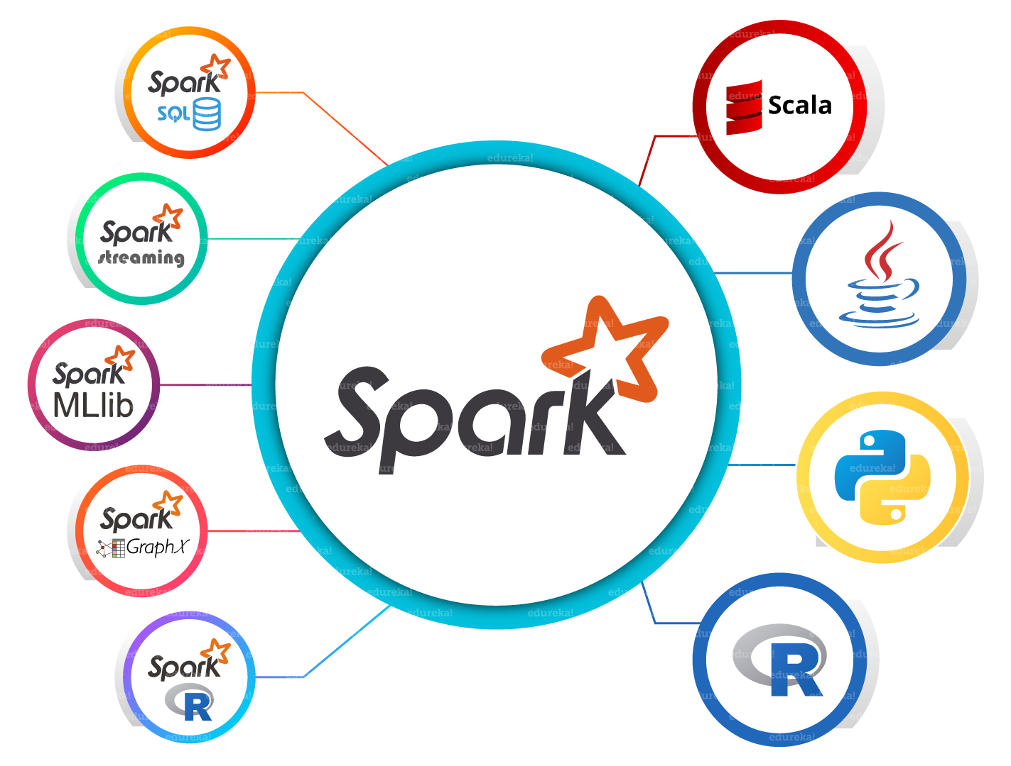

Slide 9
Spark Core
Spark Core is the base engine for large-scale parallel and distributed data processing. Further, additional libraries which are built on the top of the core allows diverse workloads for streaming, SQL, and machine learning. It is responsible for memory management and fault recovery, scheduling, distributing and monitoring jobs on a cluster & interacting with storage systems.
Spark Streaming
Spark Streaming is the component of Spark which is used to process real-time streaming data. Thus, it is a useful addition to the core Spark API. It enables high-throughput and fault-tolerant stream processing of live data streams.
Spark SQL
Spark SQL is a new module in Spark which integrates relational processing with Spark’s functional programming API. It supports querying data either via SQL or via the Hive Query Language. For those of you familiar with RDBMS, Spark SQL will be an easy transition from your earlier tools where you can extend the boundaries of traditional relational data processing.

Slide 10
GraphX
GraphX is the Spark API for graphs and graph-parallel computation. Thus, it extends the Spark RDD with a Resilient Distributed Property Graph. At a high-level, GraphX extends the Spark RDD abstraction by introducing the Resilient Distributed Property Graph (a directed multigraph with properties attached to each vertex and edge).
MLlib (Machine Learning)
MLlib stands for Machine Learning Library. Spark MLlib is used to perform machine learning in Apache Spark.
SparkR
It is an R package that provides a distributed data frame implementation. It also supports operations like selection, filtering, aggregation but on large data-sets.

Slide 11
Resilient Distributed Dataset(RDD)
RDDs are the building blocks of any Spark application.
RDDs Stands for:
Resilient: Fault tolerant and is capable of rebuilding data on failure
Distributed: Distributed data among the multiple nodes in a cluster
Dataset: Collection of partitioned data with values

Slide 12
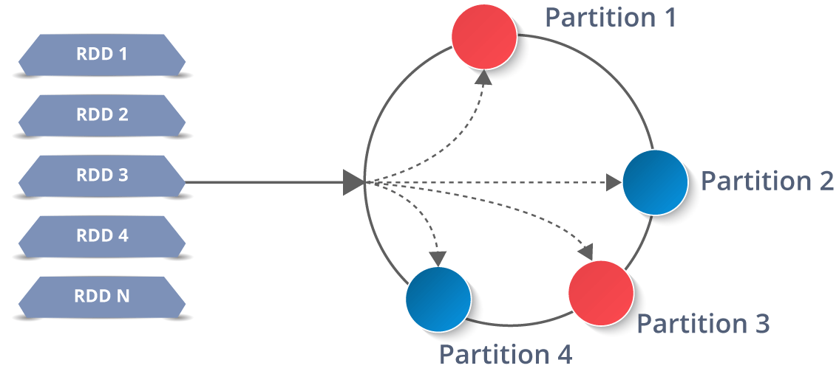

Slide 13
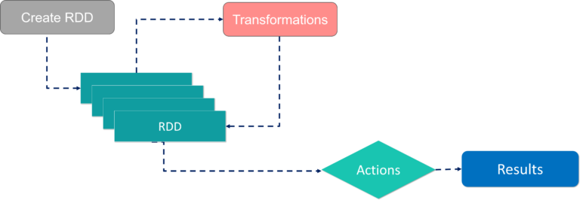

Slide 14
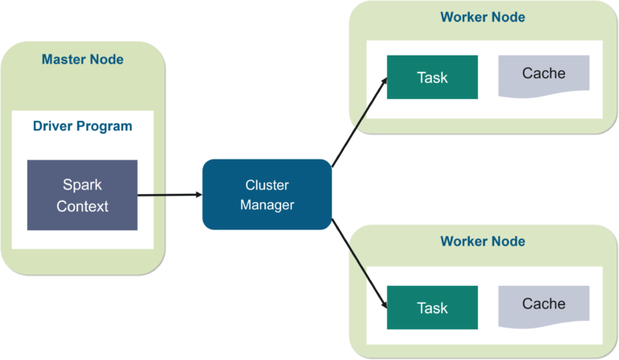

Slide 15
THANKS !

